Slide 1

Linux vs Windows
By: Dov Cattan, Hashir Dagra, Giovanni Michel

Slide 2
Introduction
An operating system mainly manages and controls a computer’s hardware
Windows is more used by consumers than Linux since it is more user friendly
Linux has 3 types of users: Regular, Administrative(root) and Service users
Windows on the other hand has 4 type of users: Administrator, Standard, Child and Guest

Slide 3
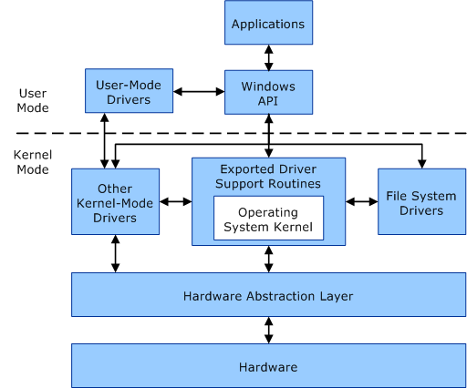
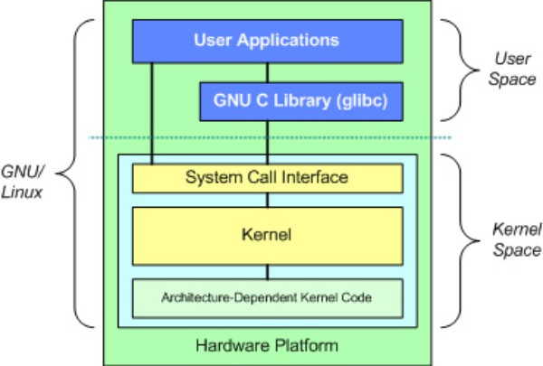
Architecture and Structure
Windows uses monolithic kernel while Linux uses a Microkernel
For the user code, Windows uses API’s while Linux uses a GNU C Library
While Linux has Kernel Code, Kernel and System Call Interface, Windows uses a Hardware Abstraction Layer, and has Kernel-Mode Drivers, File Driver, and Driver Support Routines Integrated in its Kernel

Slide 4
Process State List
New state
Ready state
Running state (Windows)/Running state and Runnable state (Linux)
Waiting state(Windows)/stopped state(Linux)
Termination state(Windows)/Zombie State(Linux)
Suspend ready(Windows)/Sleeping State(Linux)
Suspend wait

Slide 5
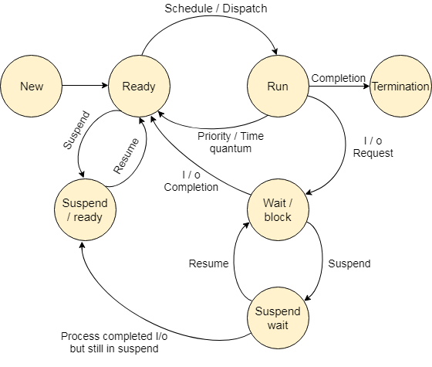
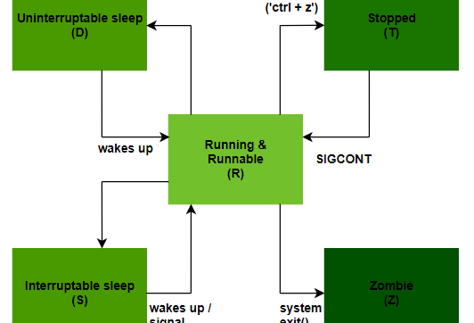
Process States Windows vs Linux
Linux and Windows slight vary in the names of states, such as zombie instead termination or sleeping instead of suspend ready.
Linux and Windows also do their process states in a different order as shown in the diagrams to the right

Slide 6
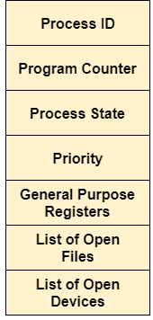
Diagram of Attributes of a Process
Process ID
Program Counter
Process State
Priority
General Purpose Registers
List of Open Files
List of Open Devices

Slide 7
Schedulers
The scheduler is special system software that processes process plans in different ways. The main task is to select the jobs to send to the system and determine the process to run.
The three types of schedulers include:
Long-term scheduler
Short-term scheduler
Medium-term scheduler

Slide 8
Schedulers Windows Vs Linux
Linux and Windows both have a Preemptive Scheduler
Linux uses the Completely Fair Scheduler (CFS) with many scheduler classes and chooses which scheduler to run based on the kernel’s priority.
Windows on the other hand chooses based on priority which parts of code to run from its scheduler located in the kernel.

Slide 9
Deadlocks
A deadlock is when the more than one process enters the waiting state due to another process holding the required resource.

Slide 10
Dead lock Detection & Prevention
The occurrence of a deadlock can be detected by the resource scheduler. The resource scheduler helps the operating system keep track of all resources assigned to different processes
It is important to prevent deadlocks before they occur. So, to prevent dead locks the system checks all transactions before execution to ensure that no deadlock conditions occur.

Slide 11
Evaluation
Because the Windows Kernel is much bigger in size than the Linux microkernel, the Windows kernel is more efficient
Windows is more user friendly to non-technical users than Linux because of it’s User Interface, While Linux is better for technical users like programmers and reverse engineers
Linux is Open Source which allows anyone to edit the operating system, while Windows is Proprietary and only people in the company can edit the operating system

Slide 12
The End

